Slide 1
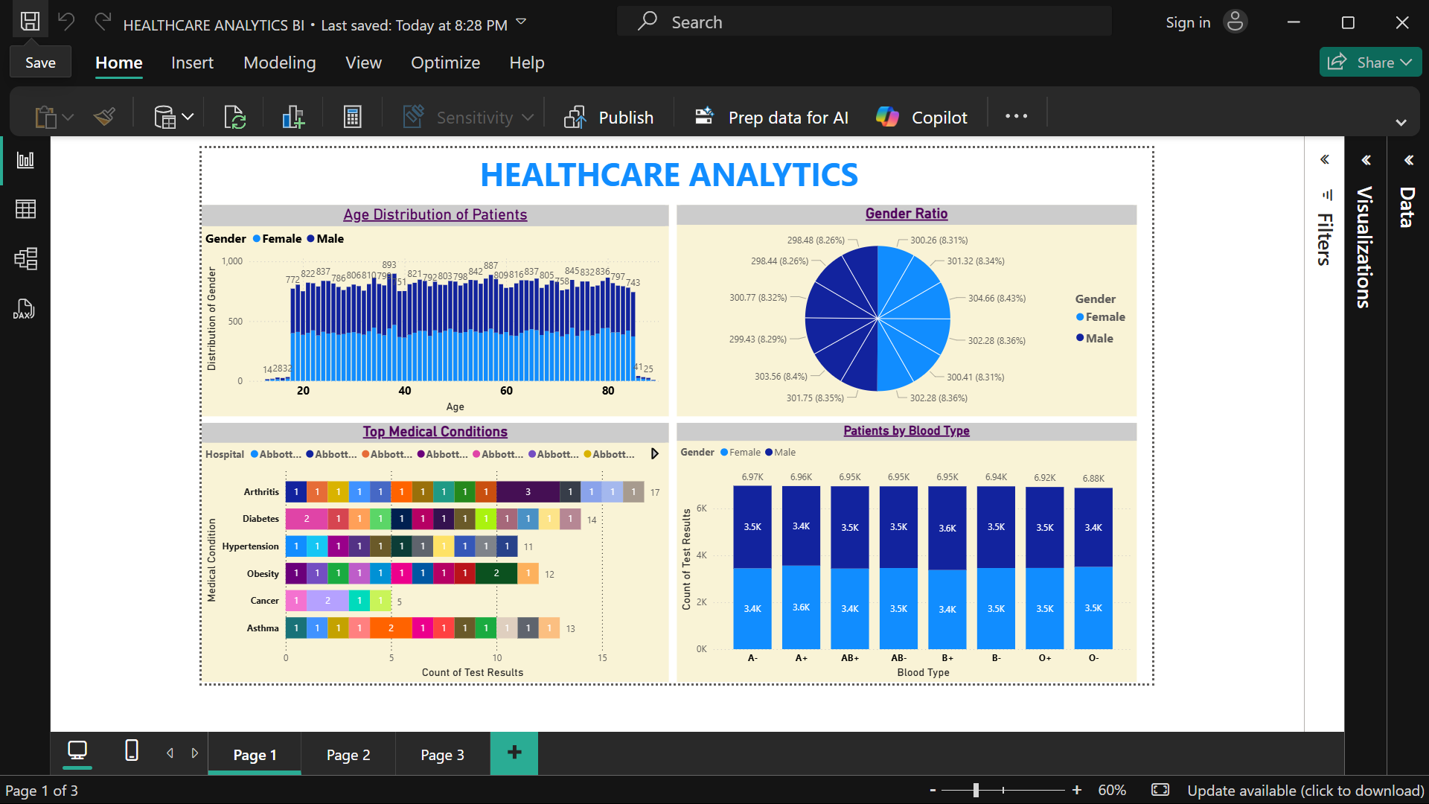
Sales Overview Dashboard
This dashboard provides a comprehensive overview of sales performance. It includes total sales, profit, number of products sold, and total orders. The bar charts represent sales by region and segment, while the pie chart shows category-wise sales distribution. The line chart illustrates total monthly sales trends throughout the year.

Slide 2
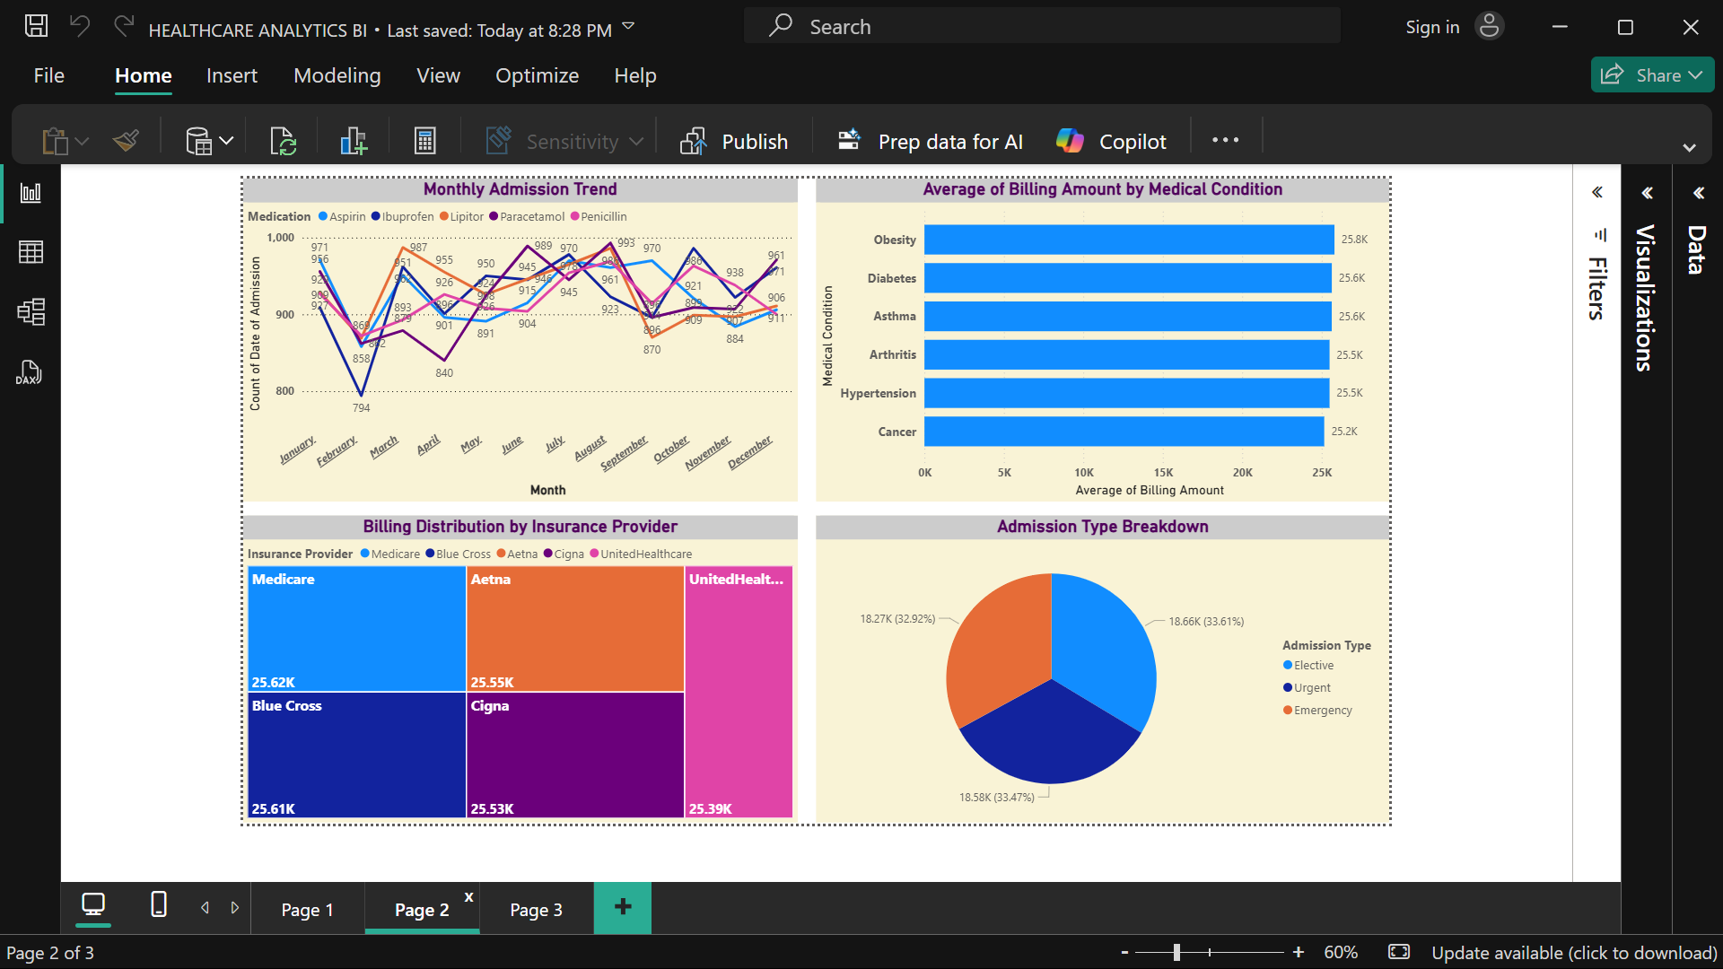
Sales and Profit Analysis Dashboard
This page focuses on profit and quantity analysis by various business dimensions. It displays total profit by category, segment, and region. The map visual highlights sales distribution across different states. A gauge chart shows total profit performance, and a waterfall chart explains monthly profit variations.

Slide 3
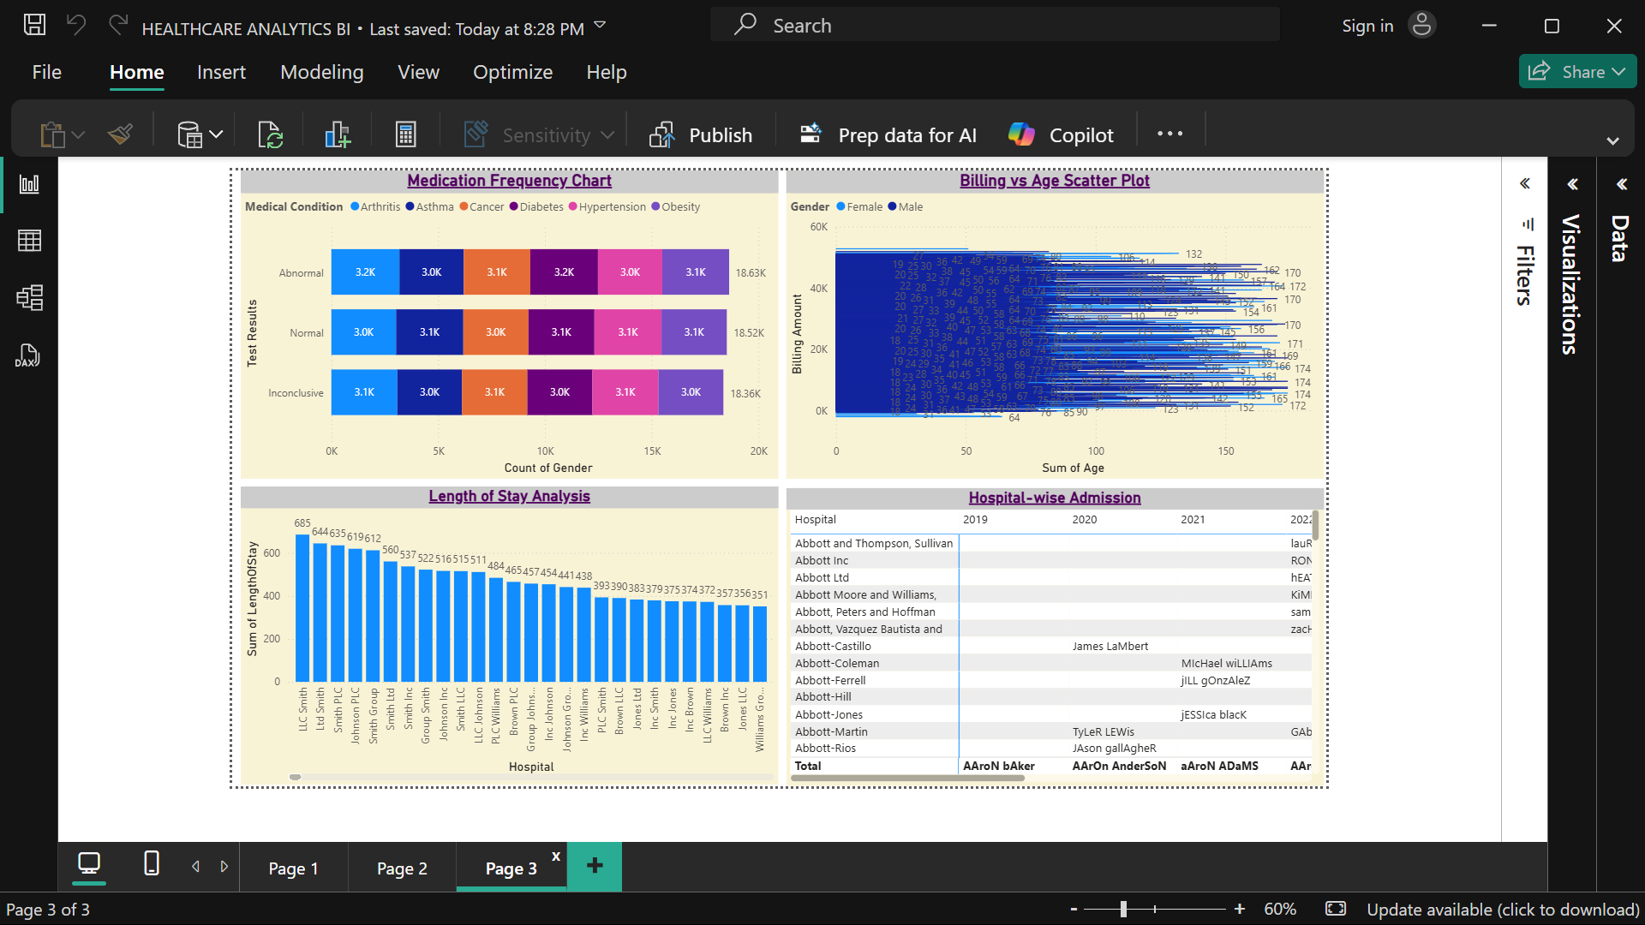
Healthcare Analytics – Patient Overview
The first healthcare dashboard provides demographic and clinical insights of patients. It displays age distribution by gender, gender ratio, and patients by blood type. Additionally, it identifies the top medical conditions across hospitals, offering a view of disease frequency and distribution.

Slide 4
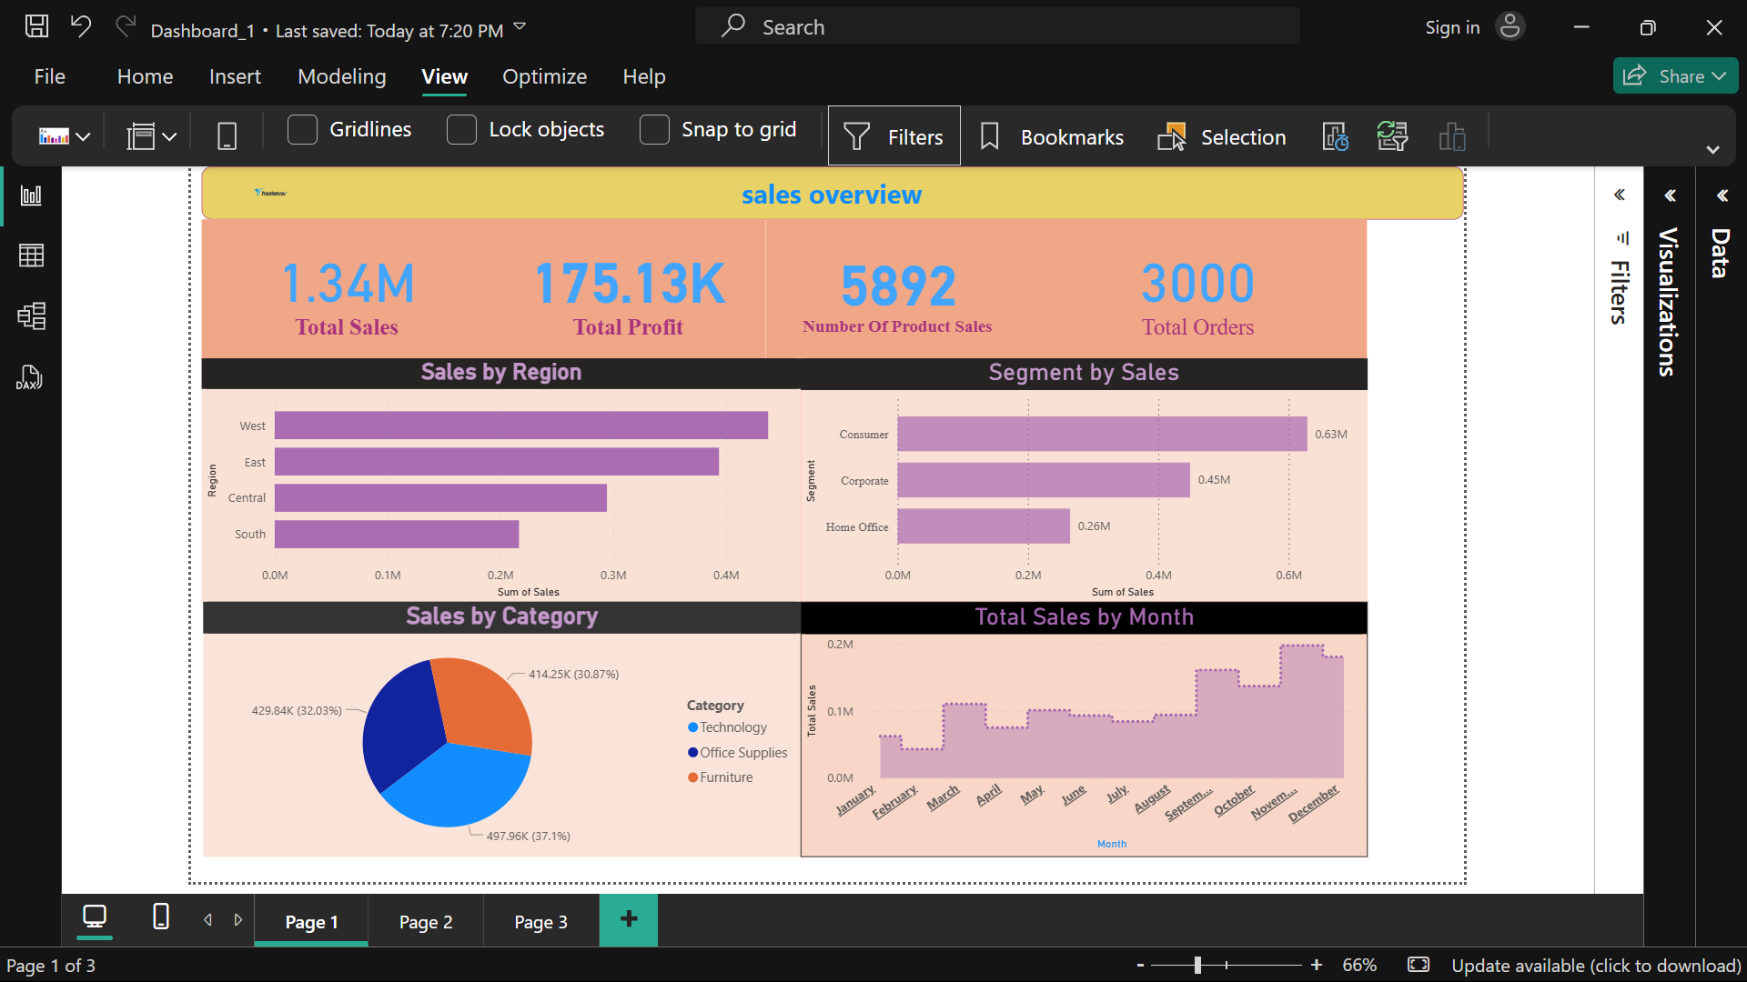
Healthcare Analytics – Billing and Admission Insights
This dashboard focuses on hospital billing and admission analytics. It shows the monthly admission trend by medication, average billing amount by medical condition, and billing distribution across different insurance providers. A pie chart summarizes admission types such as elective, urgent, and emergency cases.

Slide 5
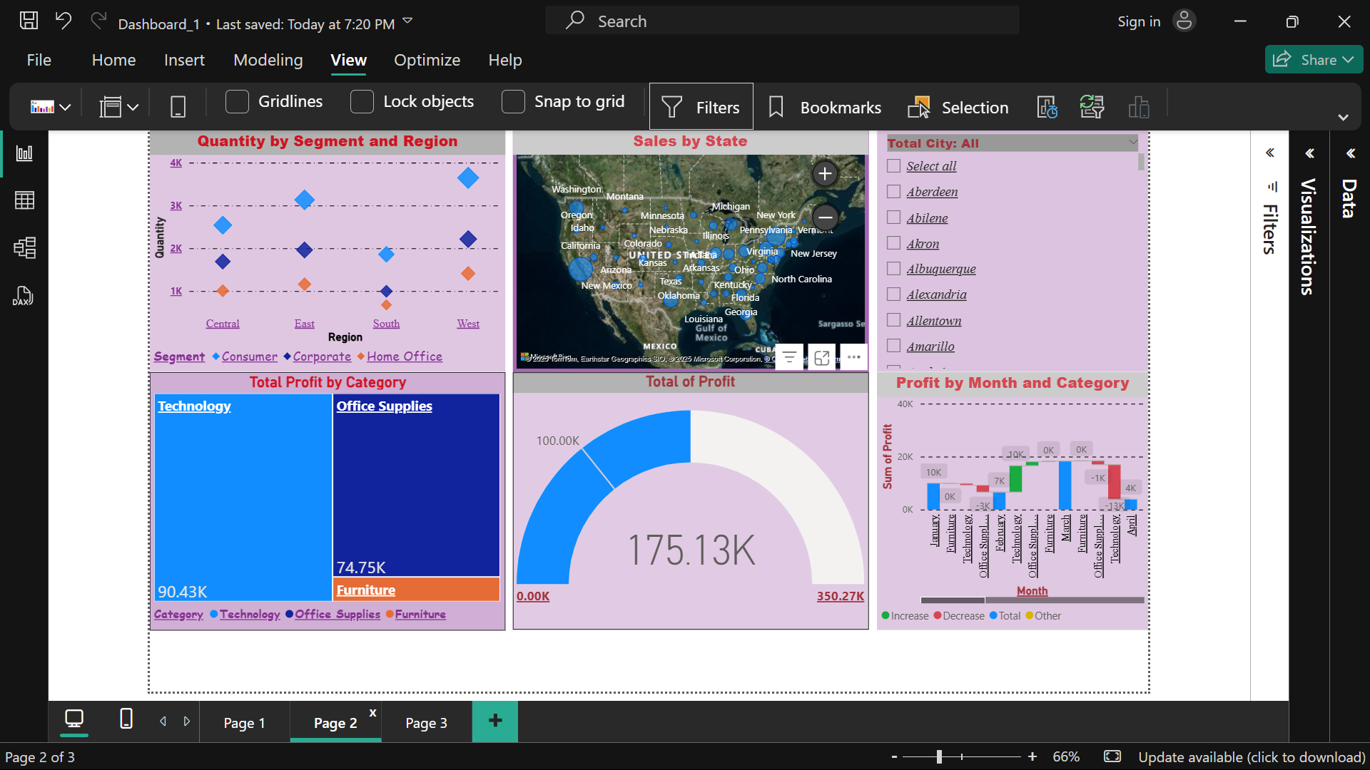
Healthcare Analytics – Hospital Performance Dashboard
This dashboard highlights hospital performance and patient management efficiency. It includes a medication frequency chart, billing vs age scatter plot, and length of stay analysis per hospital. A detailed table lists hospital-wise admissions over multiple years, providing a longitudinal view of healthcare utilization.

